Slide 1

Guess The Topic?
In a cooking adventure, where one chef focuses on a single dish while another manages multiple dishes simultaneously. Can you guess the topic of this presentation?

Slide 2
MULTITHREADING

Slide 3
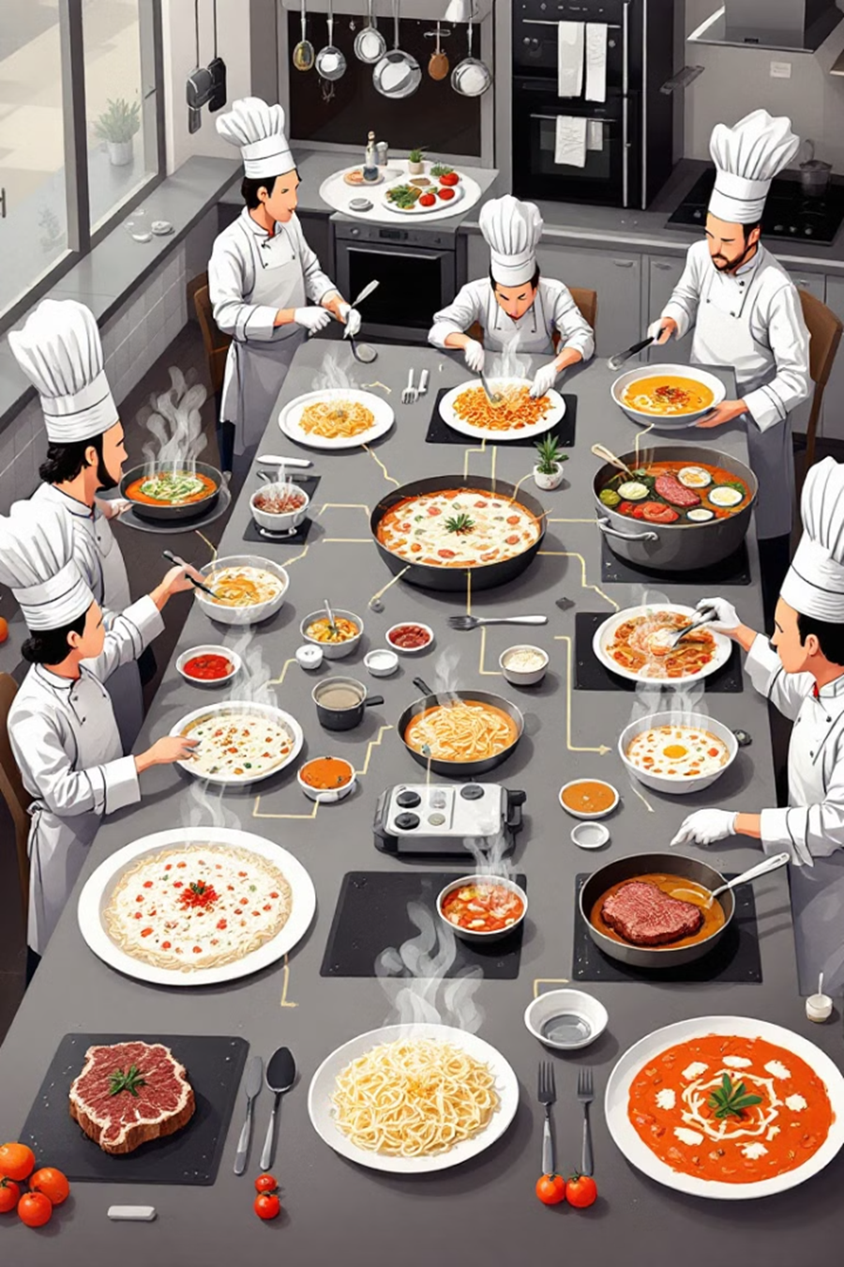
What is Multithreading?
Multithreading is a Programming concept that allows a computer or software application to execute multiple threads concurrently.
It enables different part of a program to run simultaneously.

Slide 4
THREAD VS RUNNABLE

Slide 5
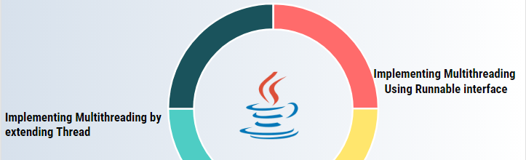
Two ways To Achieve Multithreading
Extendending thread class
Implementing Runnable interface

Slide 6
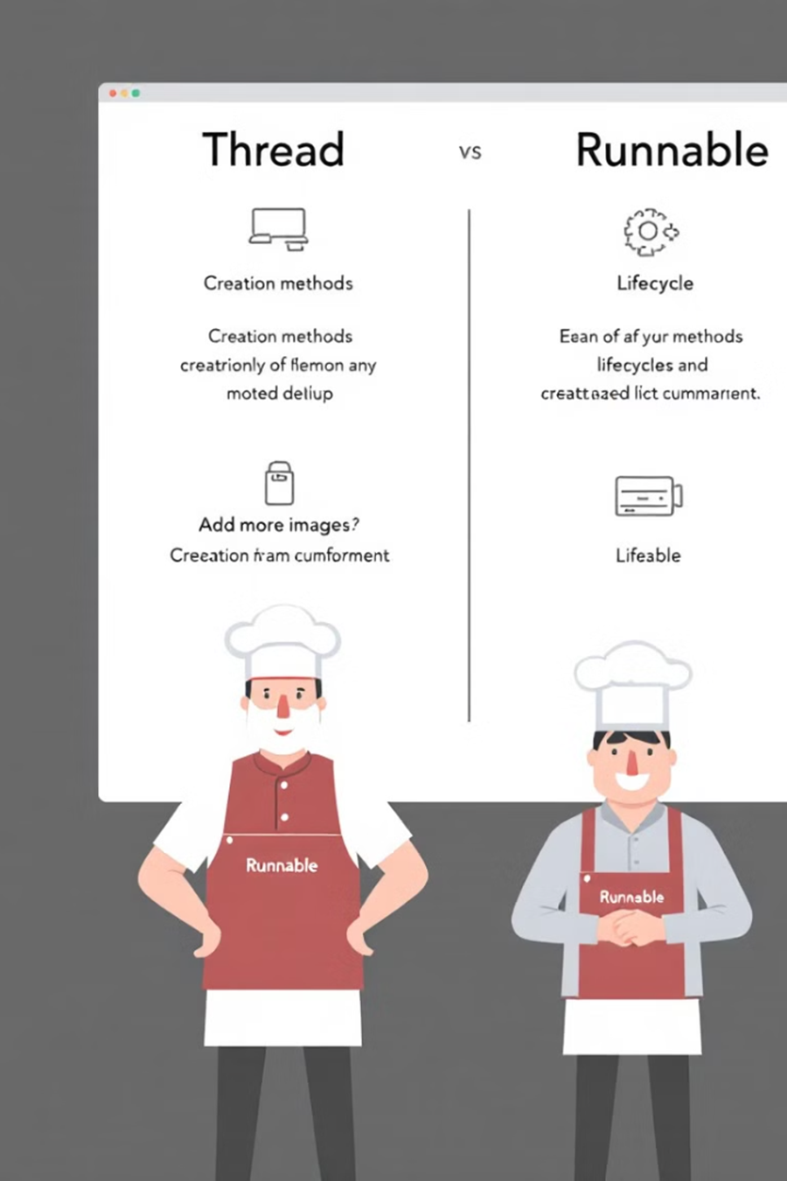

Thread vs Runnable
Runnable Interface
Allows for greater code reuse and flexibility, as the Runnable can be passed to any Thread instance.
Thread Class
Provides more functionality and flexibility, but limits the ability to extend other classes
Conclusion:
If we extend thread class , then we will not be able to extend other class. So implementing Runnable interface is the best approach

Slide 7
USER THREAD VS DAEMON THREAD

Slide 8

USER THREAD VS. DAEMON THREAD
USER THREAD
JVM waits until the execution completes
Used for Foreground task
DAEOMON THREAD
JVM doesn’t waits until the execution completes
Used for background task

Slide 9
LIFE CYCLE OF THREAD

Slide 10
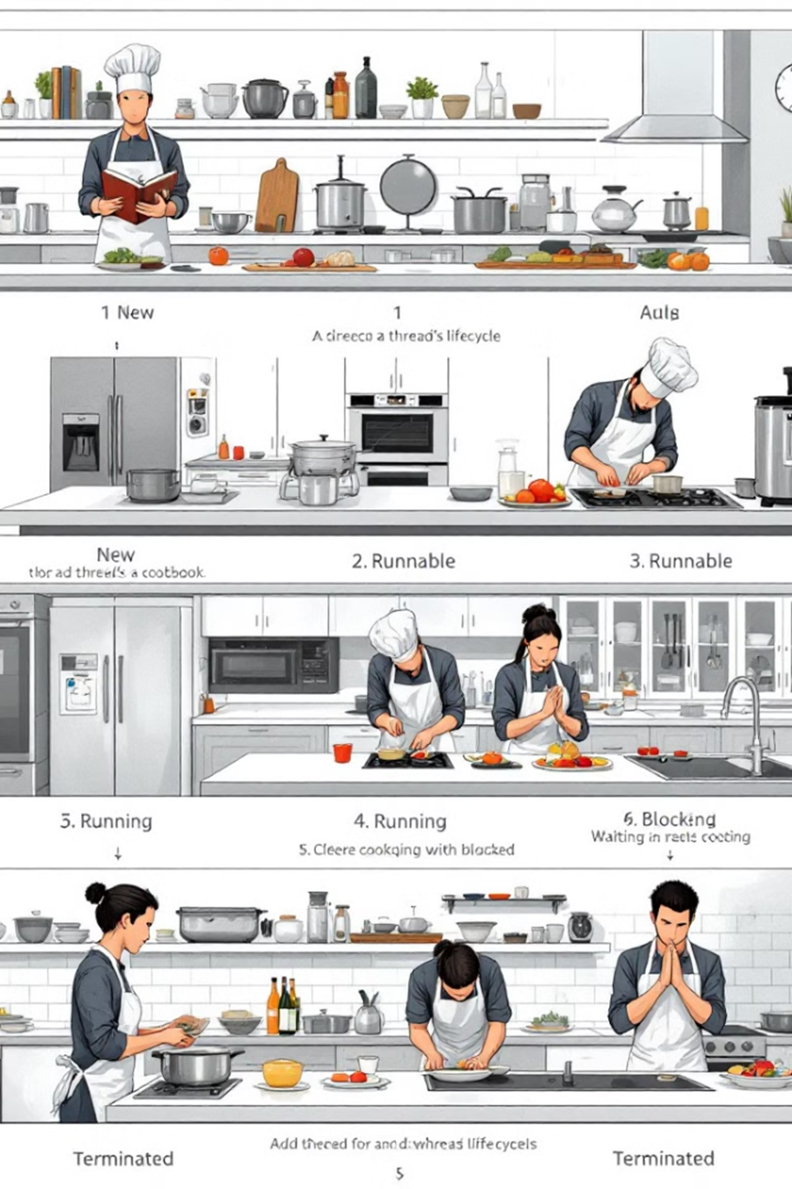
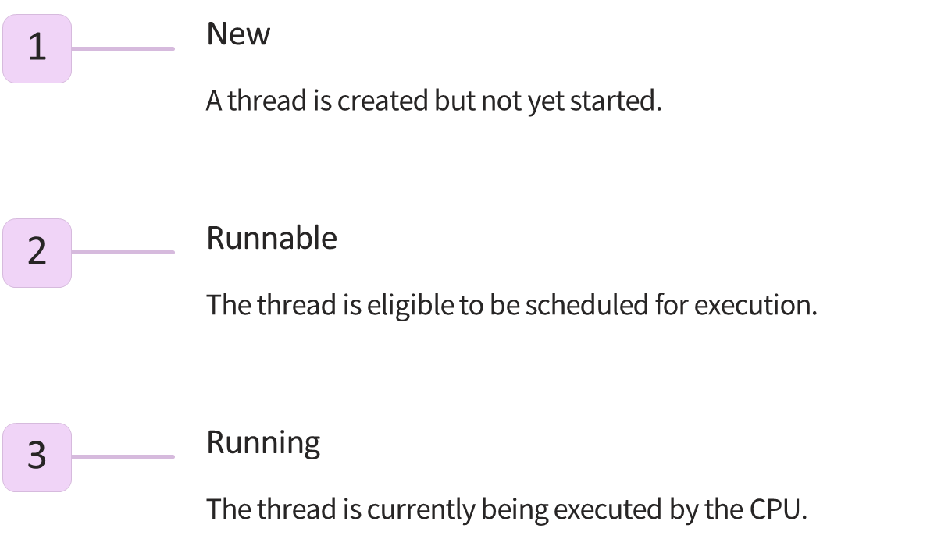
Thread Lifecycle - Birth to Death

Slide 11

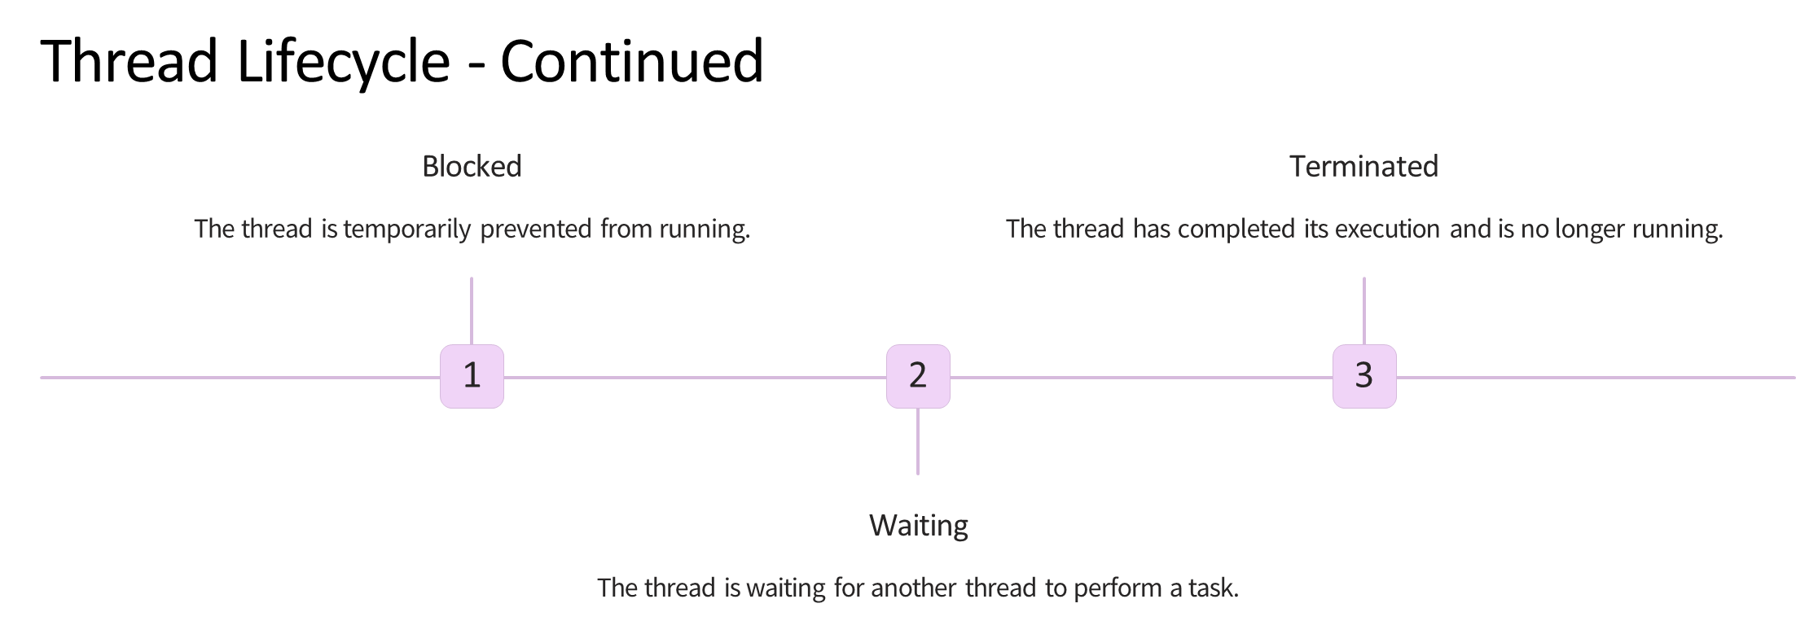

Slide 12
SYNCHRONIZATION

Slide 13
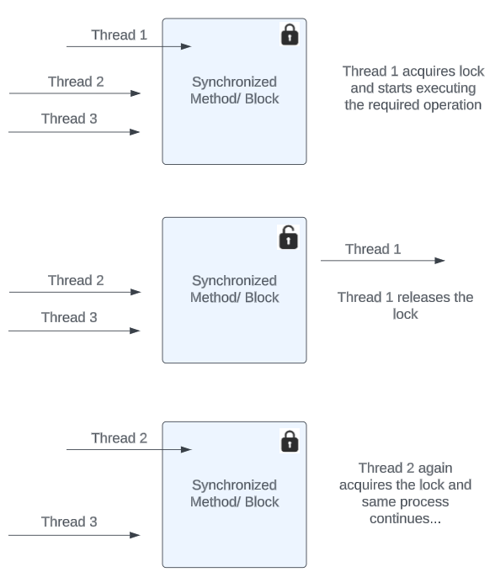
Synchronization
Synchronization in Java is a mechanism that controls access to shared resources by multiple threads

Slide 14
DEAD LOCK

Slide 15
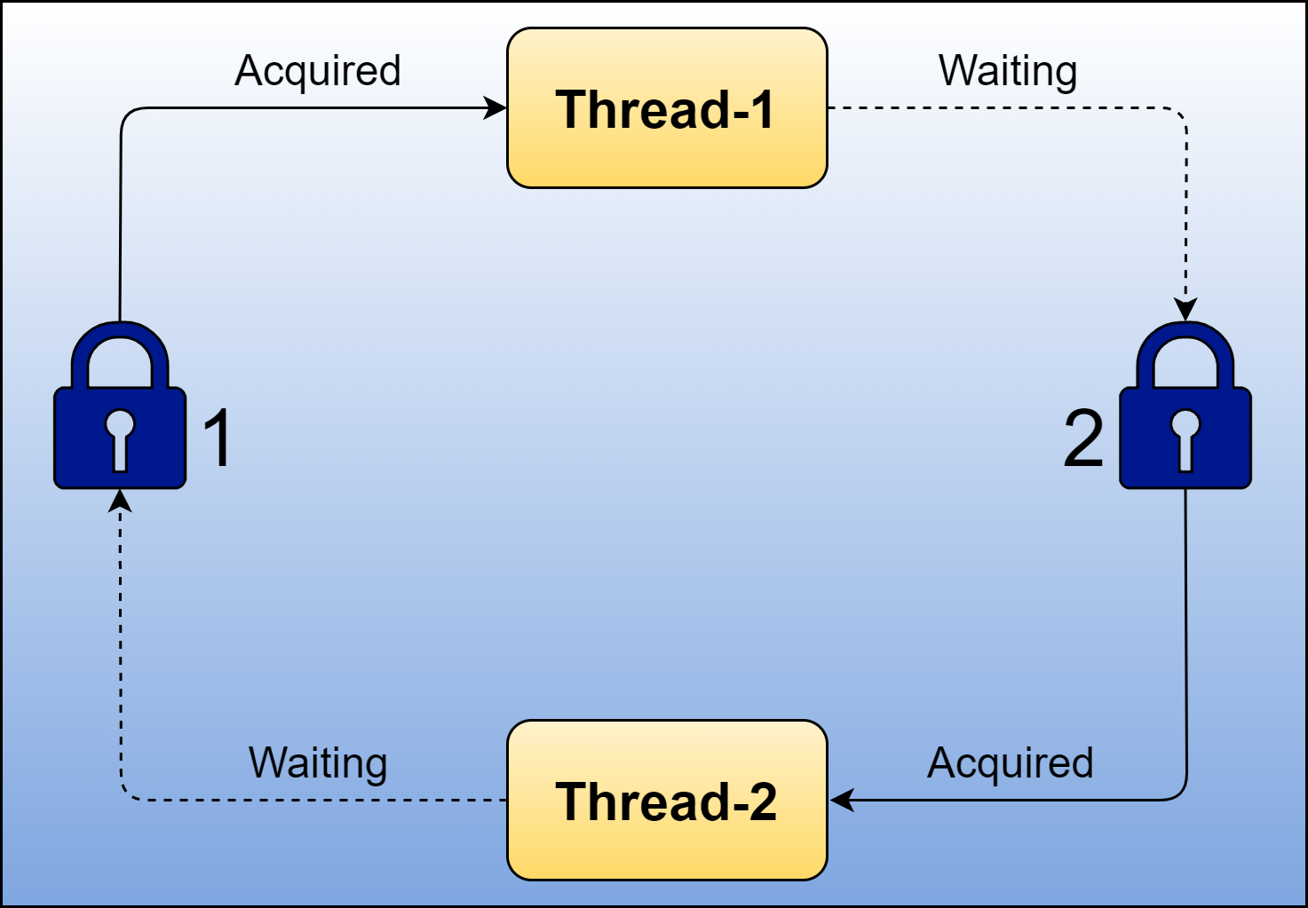
Deadlock can occur in a situation when a thread is waiting for an object lock, that is acquired by another thread and second thread is waiting for an object lock that is acquired by first thread.
Since, both threads are waiting for each other to release the lock, the condition is called deadlock.

Slide 16
THANK YOU!!
NAME:DIVYA P
EMPLOYEE ID:30019876

